Slide 1

Lab Management System
A Comprehensive Solution for Efficient Computer Lab Sessions

Slide 2
PROJECT DETAILS
LAB MANAGEMENT SYSTEM
GROUP NUMBER: | 7
MEMBERS: | ARUN GEORGE (PTA21CS020) DEEPU KOCHUMON (PTA21CS024) JIBIL JOSEPH (PTA21CS033) JISSIN SAM MATHEW (PTA21CS035)

Slide 3
INTRODUCTION
Comprehensive solution designed to enhance the efficiency and effectiveness of computer lab sessions
To enhance computer lab efficiency for both students and faculty.
It assists students and teachers

Slide 4
LITERATURE SURVEY
Resource Allocation and Scheduling
S. Wang, H. Li, and Y. Liu, "An Intelligent Resource Management System for University Computer Labs“[1].
Security Measures
E. H. Kim and J. H. Park, "Enhancing Security in University Computer Labs through Network Segmentation and Anomaly Detection“[2].
Intergration And Usability
C. L. Hsu and Y. L. Chiu, "Usability Evaluation of Computer Lab Management Systems: A Case Study“[3].

Slide 5
CHALLENGES FACED TODAY
Delays in accessing their lab section attendances
Viva marks is visibility
Clear guidance
Communication Channels.
Scheduling Conflicts.

Slide 6





ABSTRACT
Attendance Tracking for Real-time Insights
Coding Program Enhancement
Continuous Improvement through Student Feedback
Dashboard for Streamlined Administration
Enhanced Communication Channel

Slide 7
FEATURES
Better UI Designing
Attendance Tracking & Marking
Student Review system
Doubt clearance
Lab Scheduling
Announcements
Feedback System

Slide 8



TOOLS USED
FRONT END:
BACK END:

Slide 9
EXPECTING OUTPUT
Purpose: Serves students and faculty
Features for students:
View attendance
Check viva marks
Access lab details and schedules
Review course portions
Benefits for Students:
Improves lab performance
Reduces stress
Efficient status tracking

Slide 10
EXPECTING OUTPUT
Features for faculty:
Manage students
Communicate effectively
Send targeted messages (lab sessions, assignments, updates)
Key functionalities:
Students list
Viva marks tracking
Attendance records
Lab allotment and schedules
Faculty details
Student reviews
Lab syllabus
Faculty instructions

Slide 11
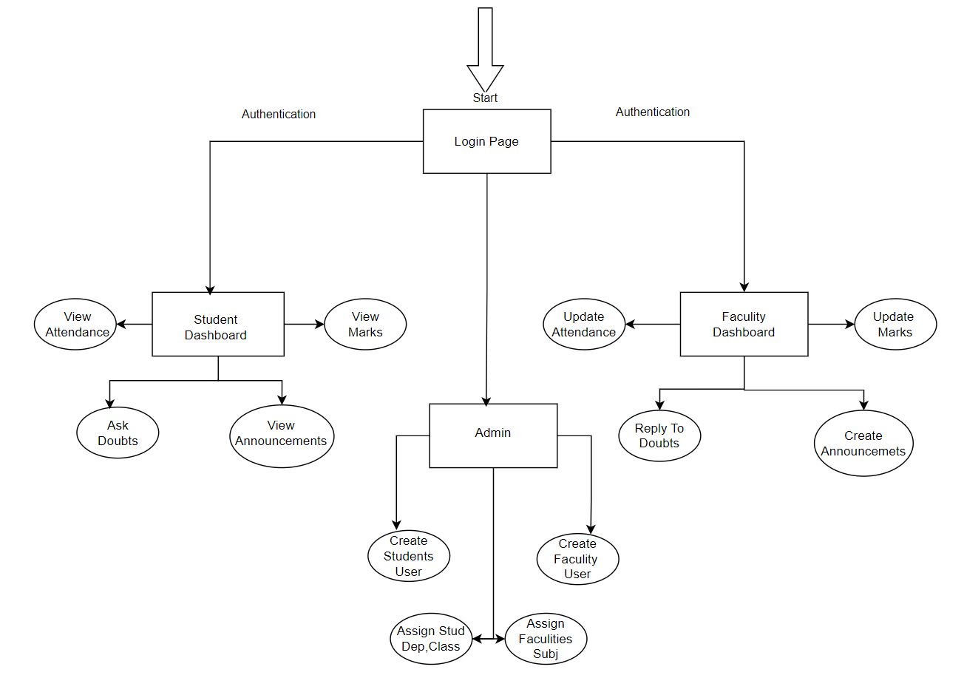
BLOCK DIAGRAM

Slide 12
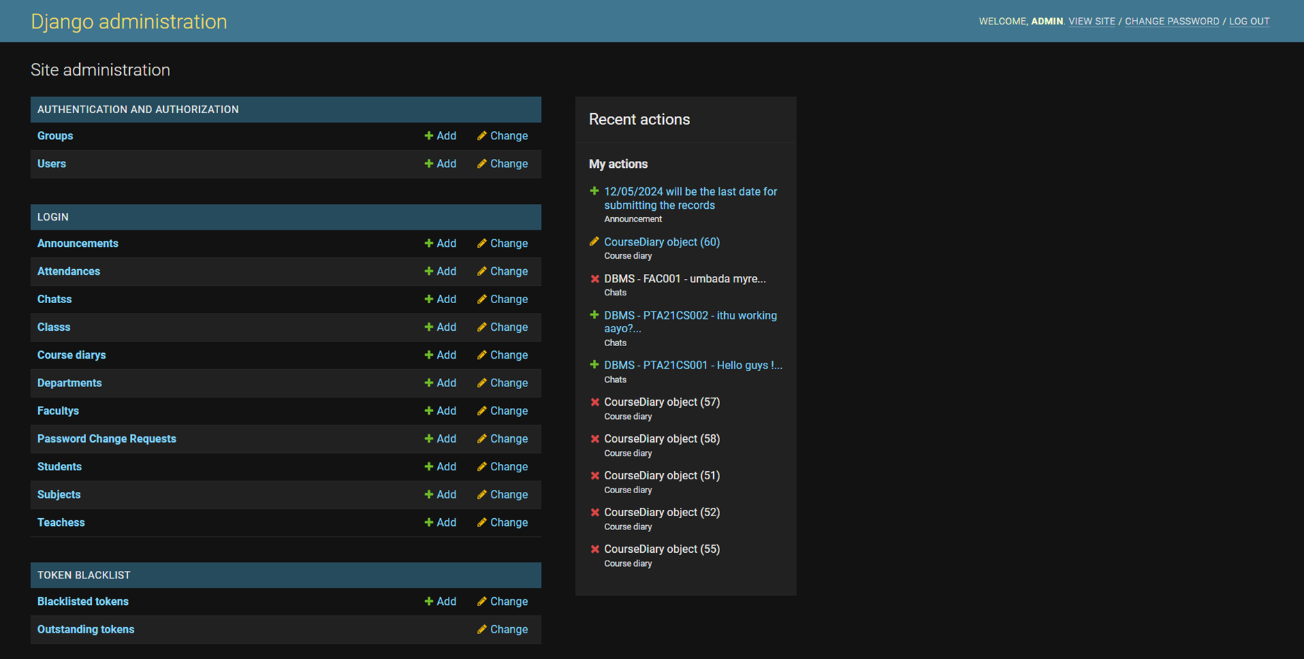
DATABASE

Slide 13
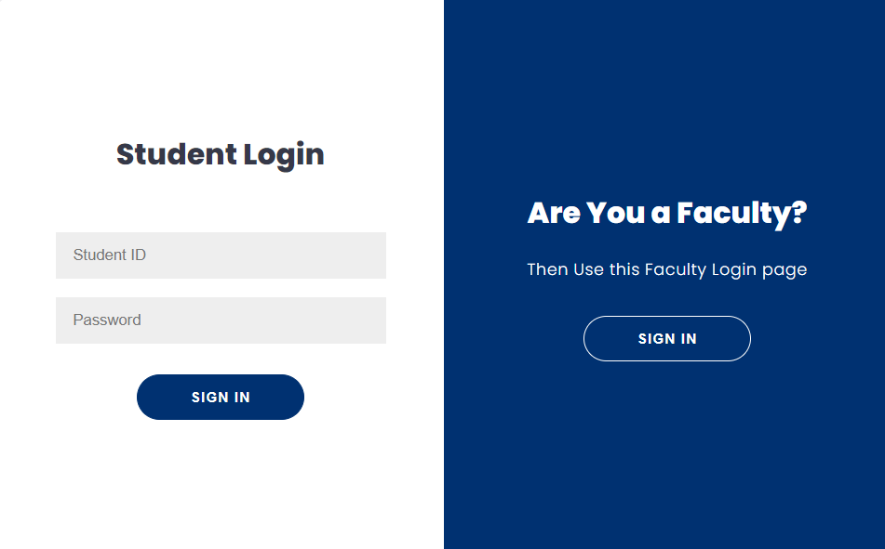
Login Page-Student Login

Slide 14
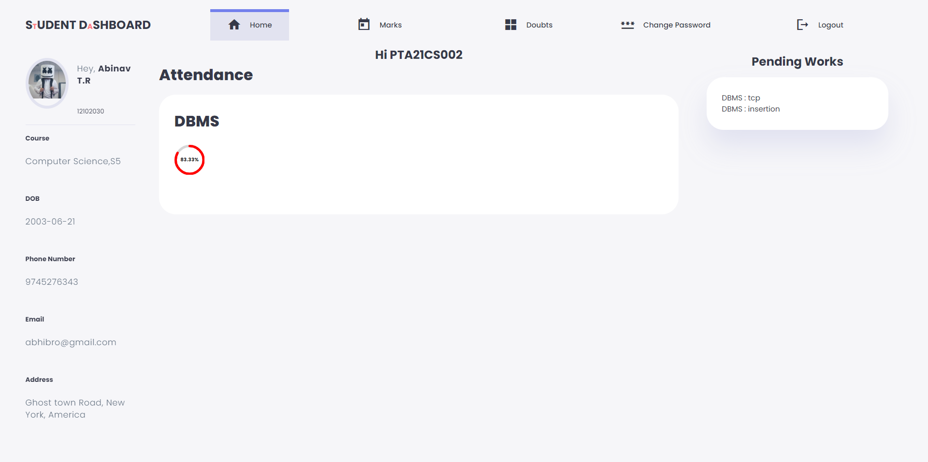
Student DashBoard-Home

Slide 15
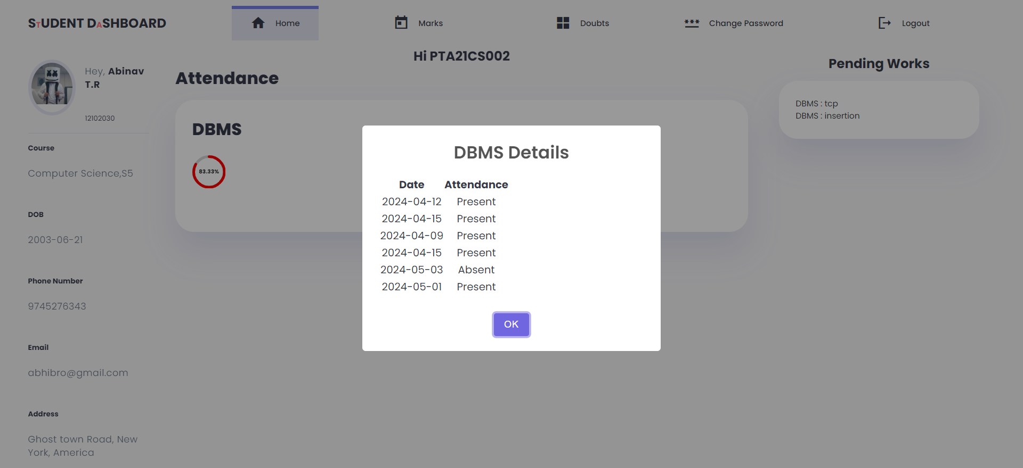
Student DashBoard-Home

Slide 16
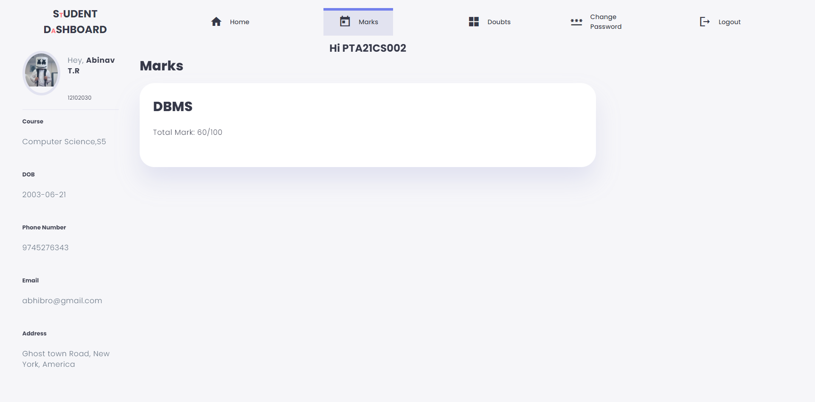
Student Dashboard -Marks

Slide 17
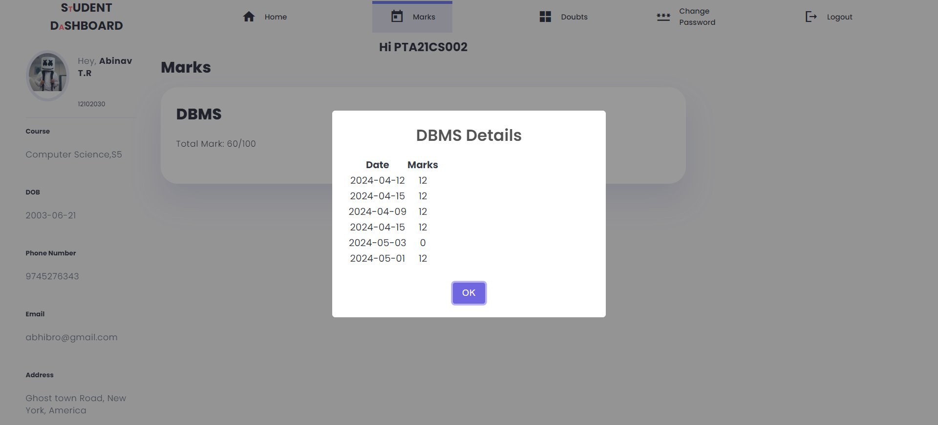
Student Dashboard -Marks

Slide 18
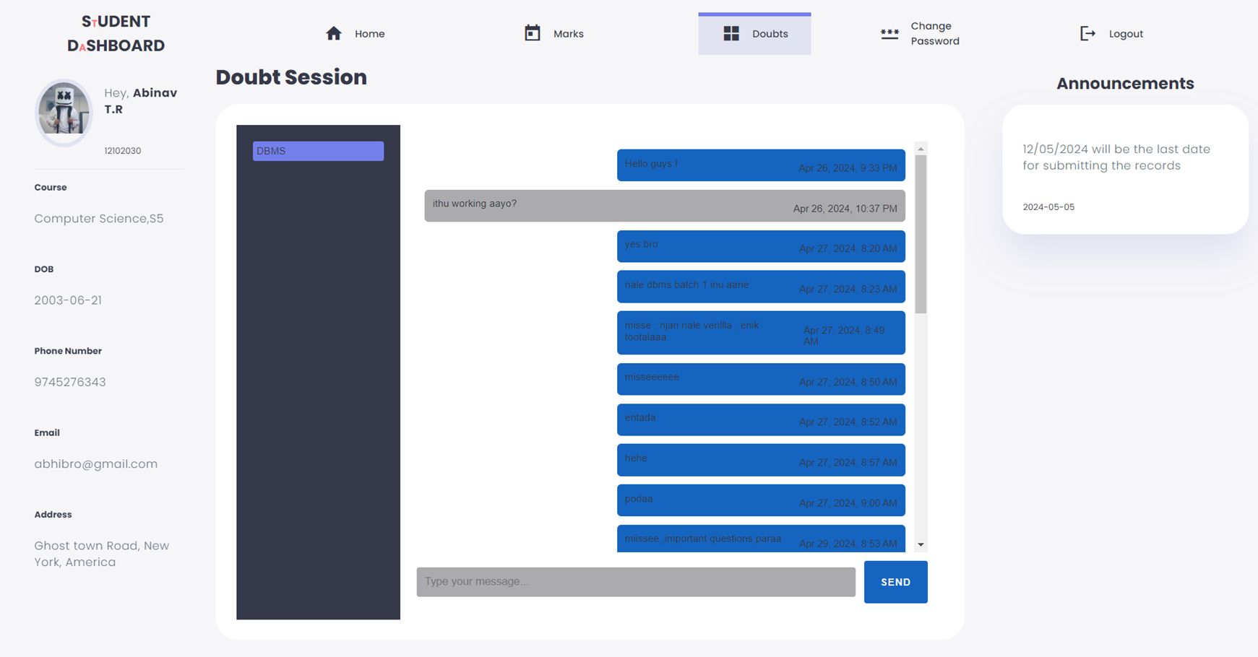
Student Dashboard -Doubts

Slide 19
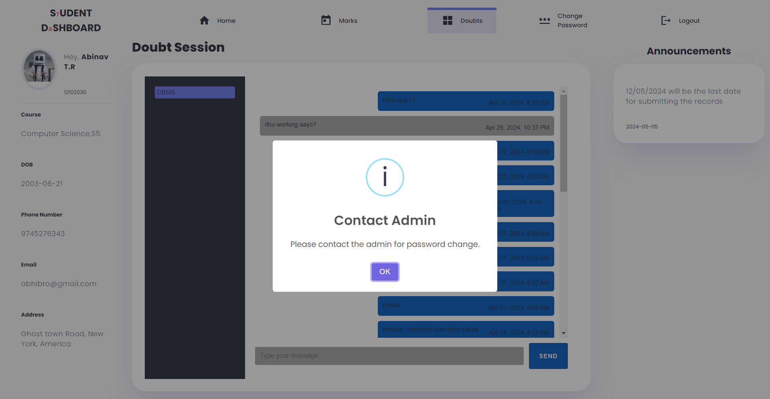
Student DashBoard-Change Password

Slide 20
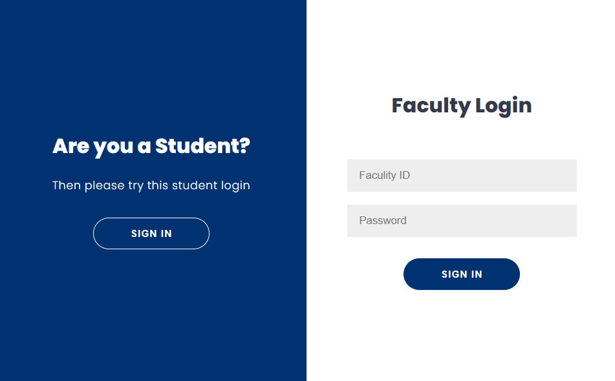
Login Page-Faculity Login

Slide 21
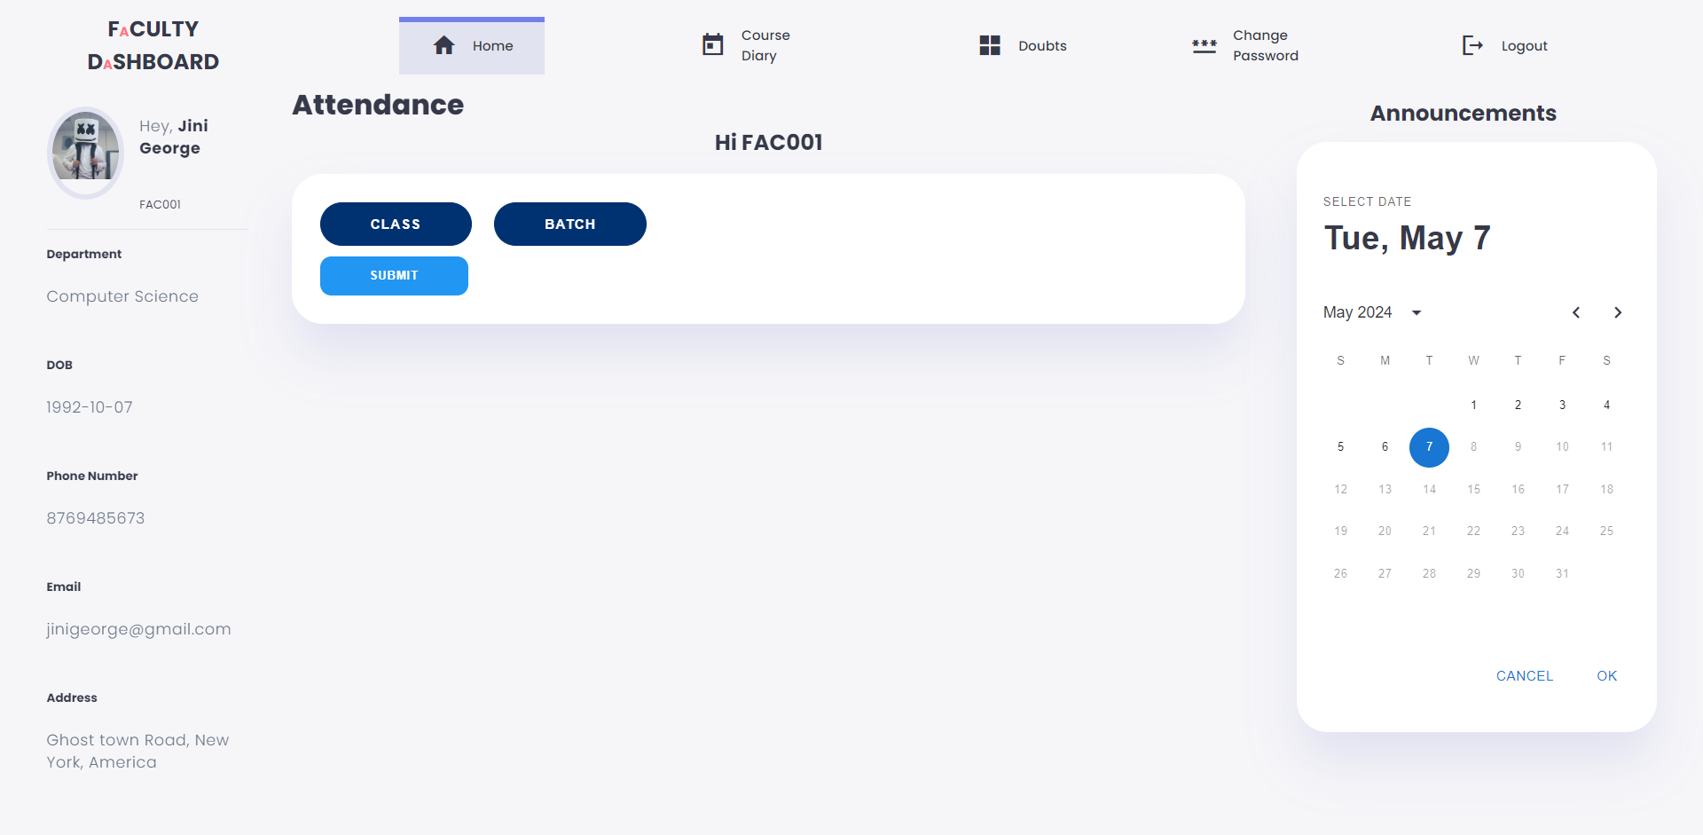
Faculity DashBoard-Home

Slide 22
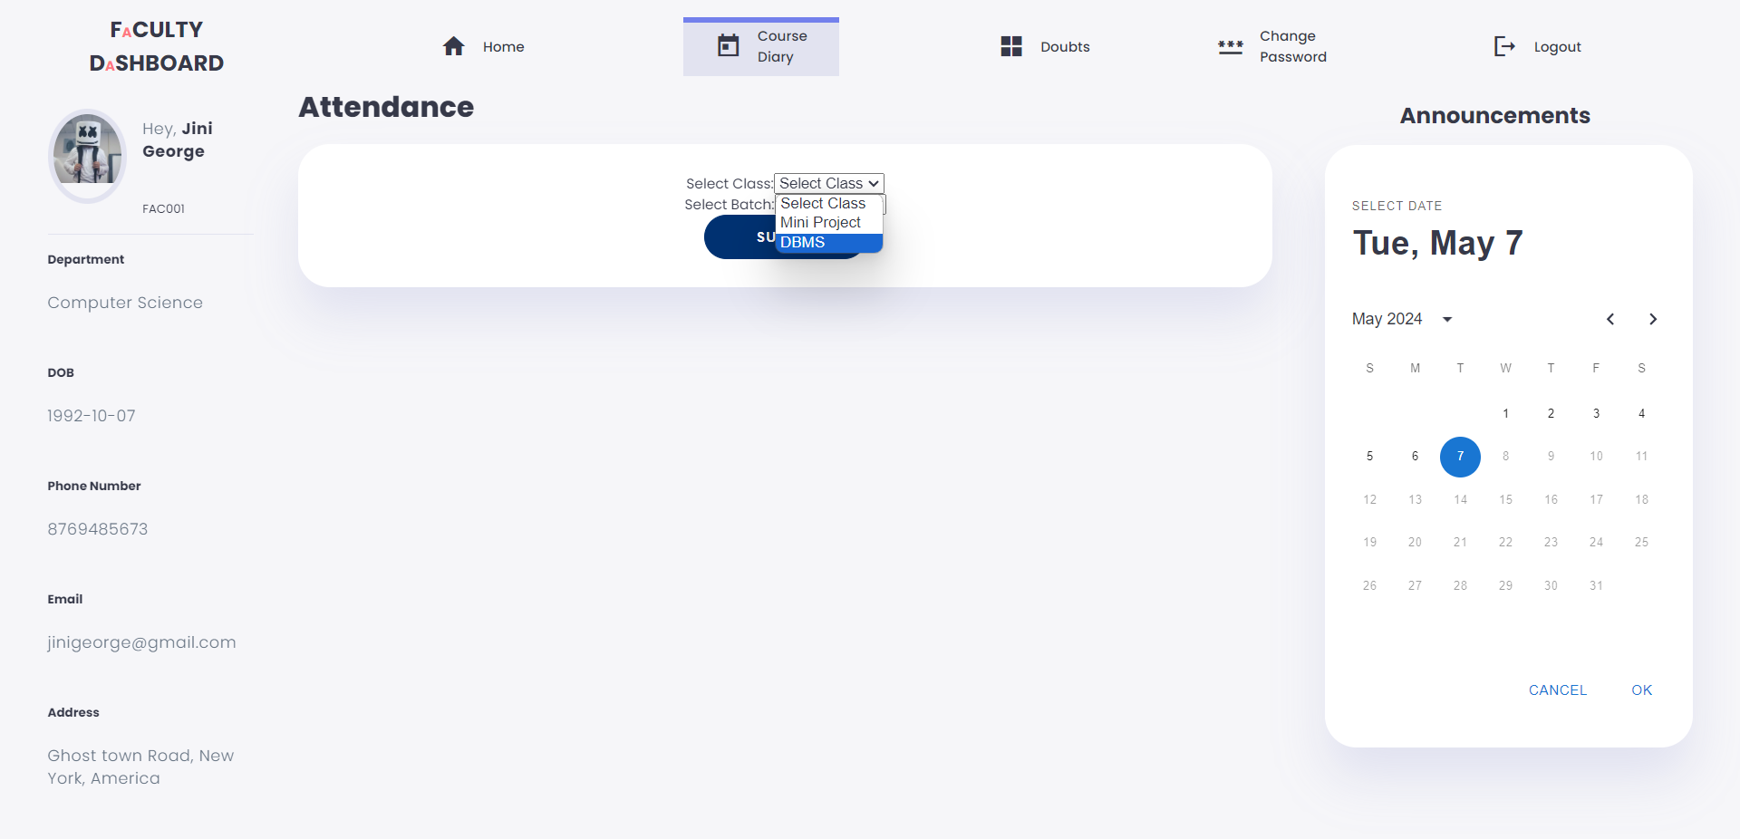
Faculity DashBoard-Course Diary

Slide 23
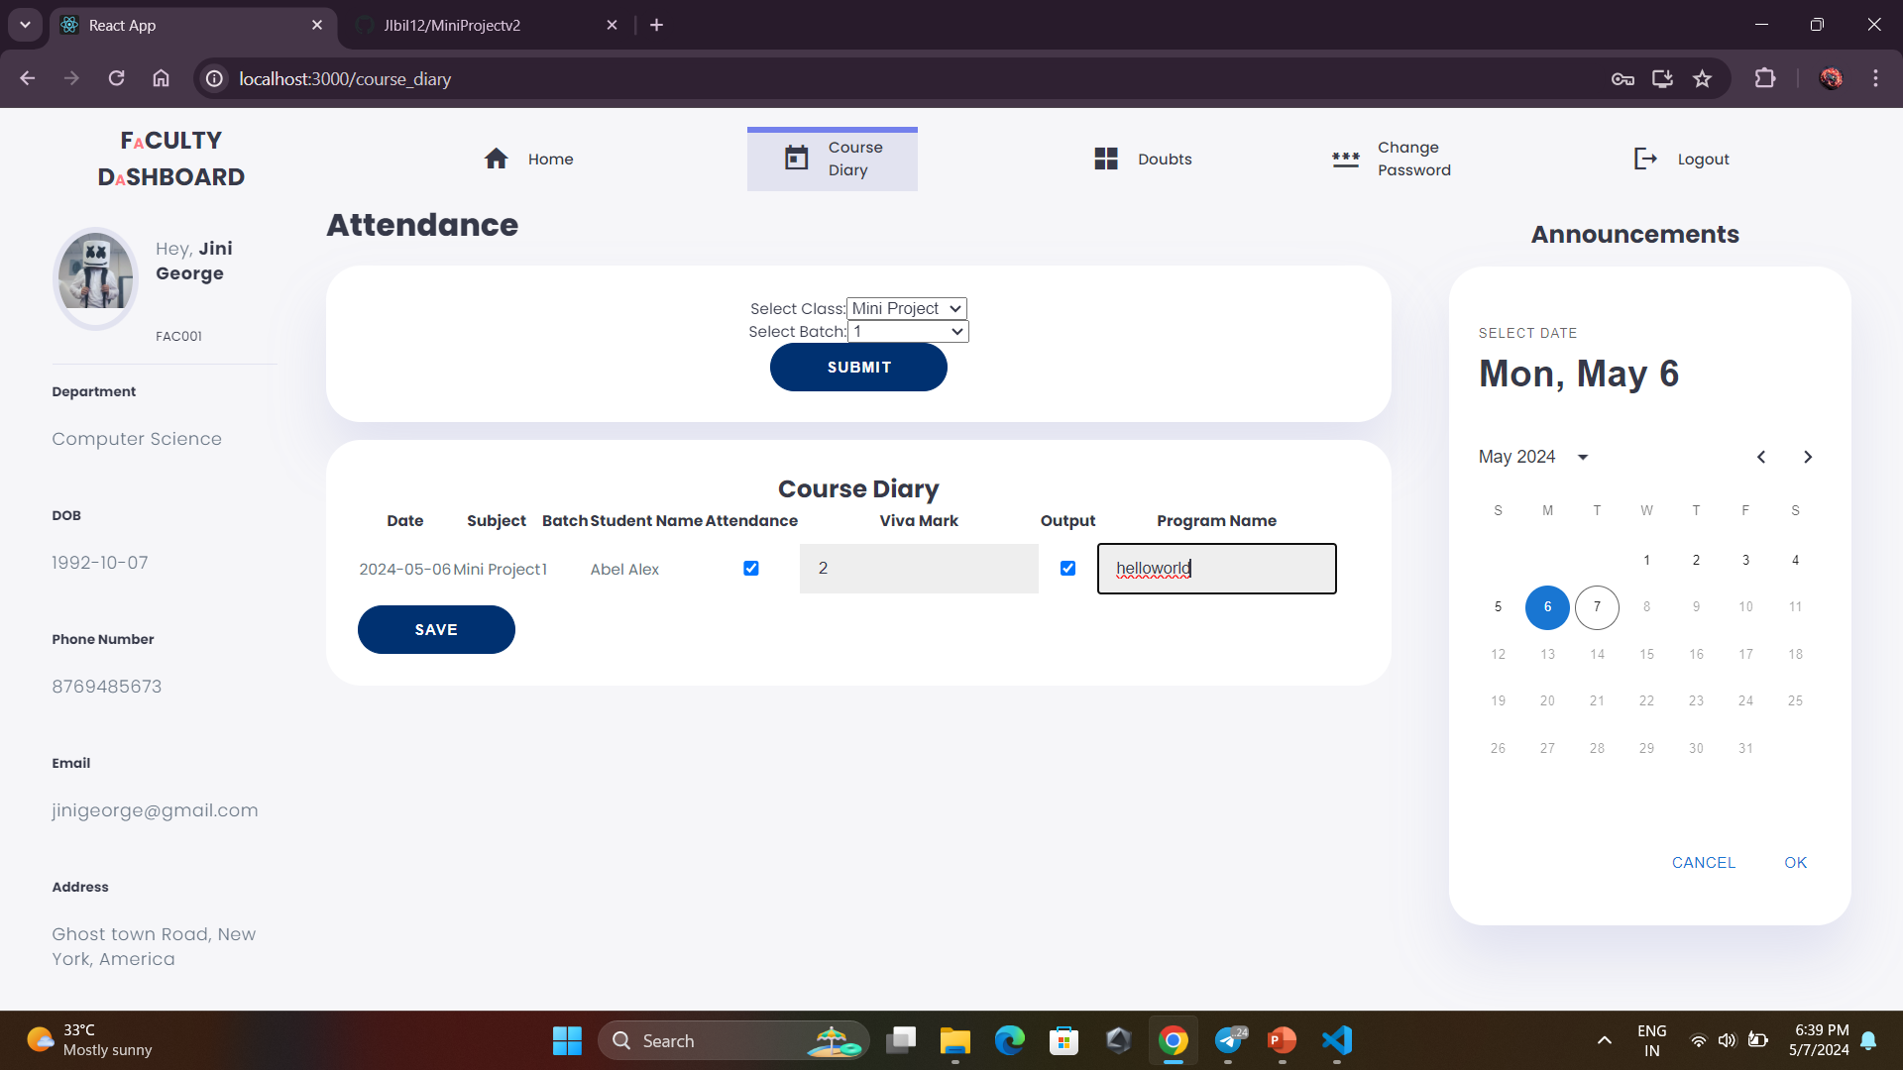
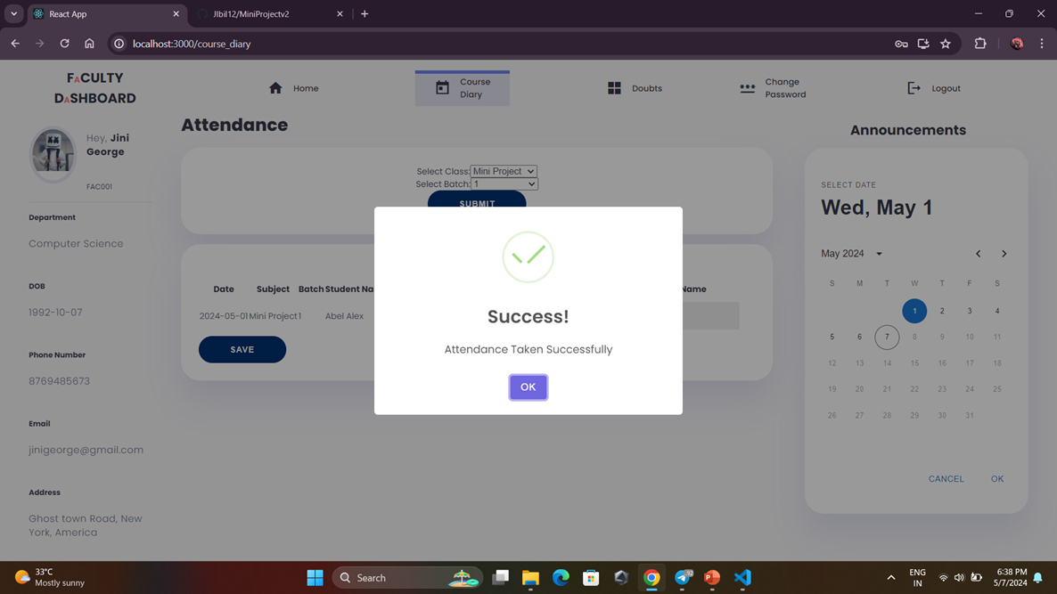
Faculity DashBoard-Attendance Taking

Slide 24
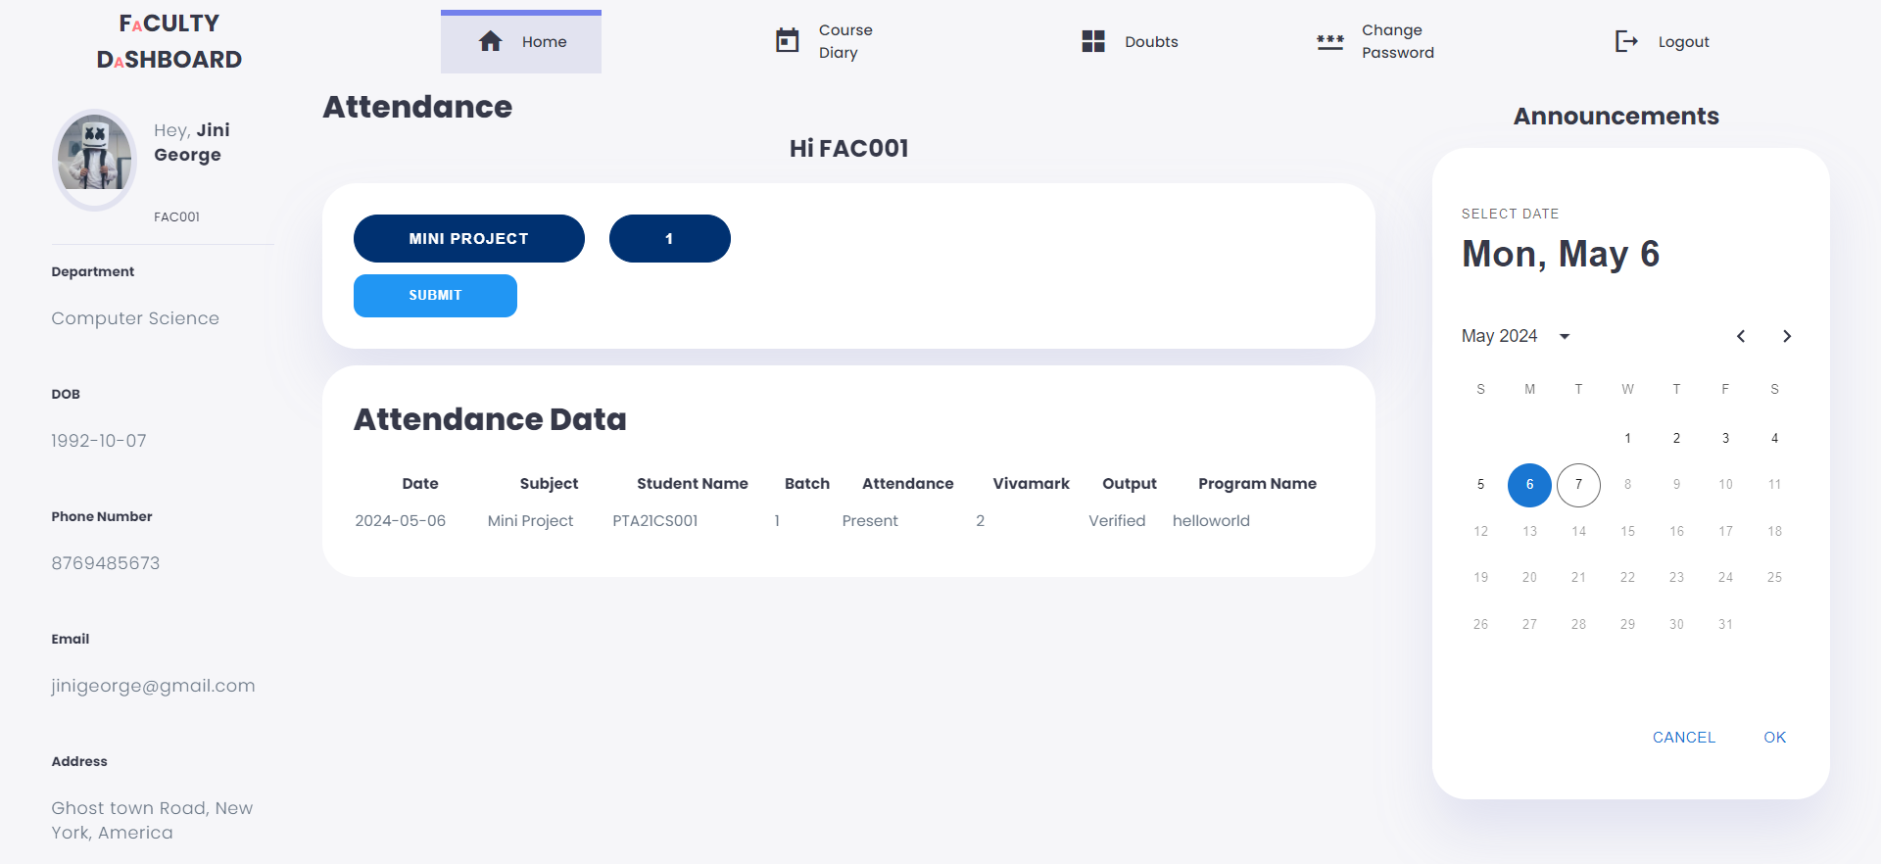
Faculity DashBoard- Home After Attendance Taking

Slide 25
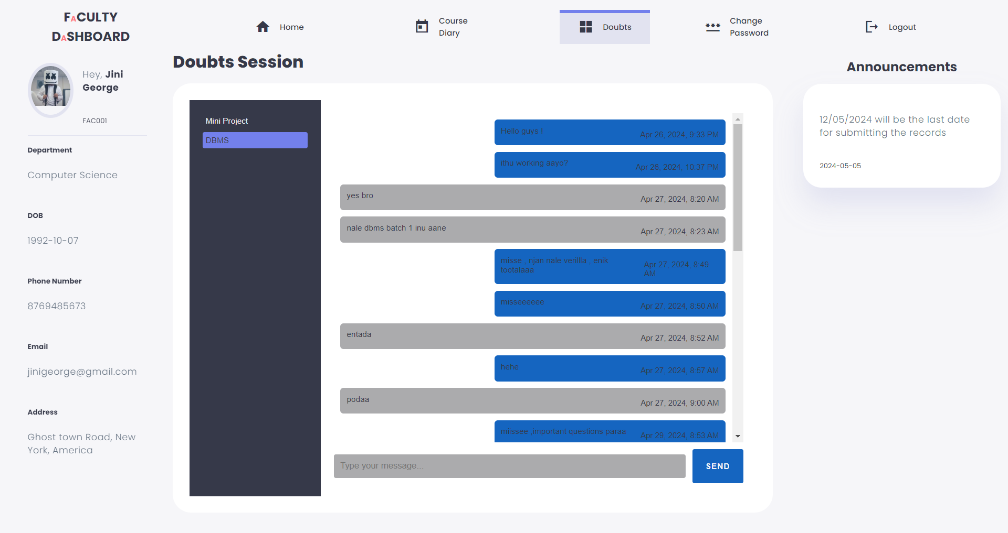
Faculity DashBoard-Doubts

Slide 26
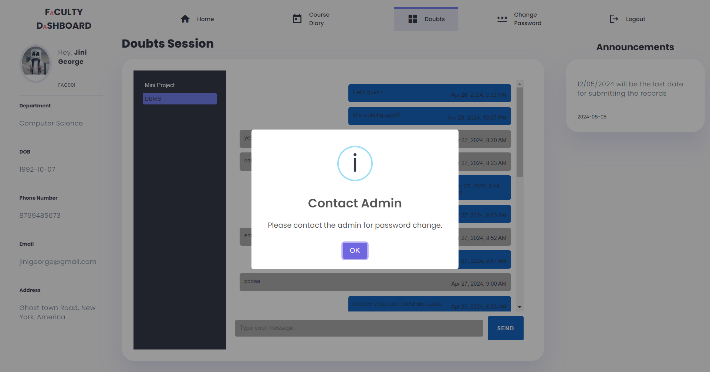
Faculity DashBoard-Change Password

Slide 27
CONCLUSION
The Computer Lab Management System presented in this project seeks to create a harmonious and efficient learning environment for both students and faculty. By addressing key aspects such as schedules, attendance, coding errors, student feedback, and faculty communication, the system aims to foster a collaborative and effective computer lab experience.

Slide 28
REFERENCES
[1] S. Wang, H. Li and Y. Liu, “An Intelligent Resource Management System for University Computer Labs,” IEEE Transactions on Education, vol. 60, no. 3, pp. 234- 240, Aug 2017.
[2] L. Green, “Predictive Maintenance in Computer Laboratories Using IoT and Machine Learning,” IEEE Internet of Things Journal, vol. 6, no. 5, pp. 8594-8602, Oct 2019.
[3] C. L. Hsu and Y. L. Chiu, “Usability Evaluation of Computer Lab Management Systems: A Case Study,” IEEE Access, vol. 8, pp. 12567-12576, 2020.

Slide 29

Thank You

